Slide 1
Virtual digital signal processing using LabVIEW
With signal processing applications for ac susceptibility measurements
Project Report
R K Rupesh
Mentors – Dr Joby Antony & Rajesh Nirdoshi
Notes:
Hello everyone, my name is Rupesh, im doing my integrated masters in physics from university of hyderabad

Slide 2
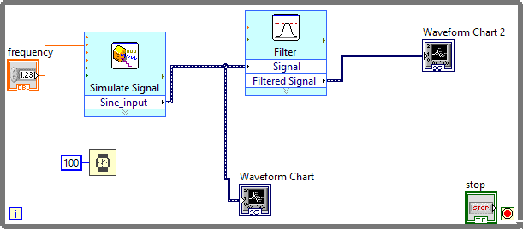
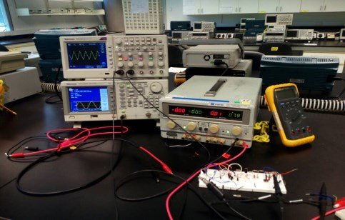
Virtual instrumentation
Virtual instruments are a fundamental shift from traditional hardware-centered instrumentation
Environmental Noise-free Processing
software-centered systems exploit computing power and connectivity capabilities of PC
e.g. Virtual world during Covid-19 !!!
Notes:
Virtual instruments are fundamentaly different from hardware based instrumentation like oscilloscopes, signal generators etc since they capitalize on the computational power of a computer to perform the tasks

Slide 3

Noises
There’s noise in every measurement!
Real world Images
DISCRIMINATOR
TRUE
Noise Generator
FALSE
Notes:
Hence we have to come up with some system to differenciate the noise from the signal

Slide 4
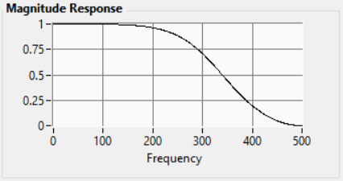
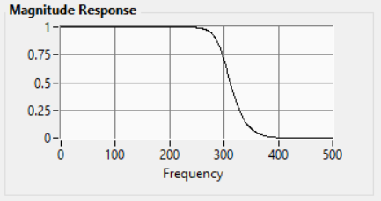
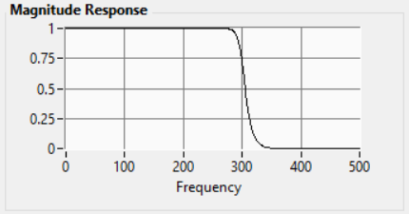
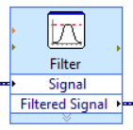
Digital Filters
a) Order 2
b) Order 8
c) Order 13
Digital filters offer highly customizability without disturbing the circuit
Temperature Independent function
They have a steep frequency response
Linear phase shift
Notes:
That brings us to the idea of using digital filters for signal processing. Temperature drift

Slide 5
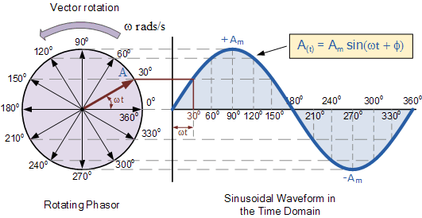
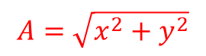
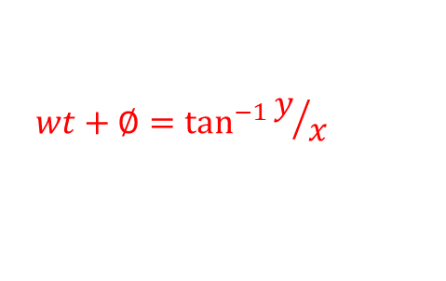
Phasor diagram
$$A=\sqrt{x^{2}+y^{2}}$$
$$wt+∅=\tan^{−1}{y/x}$$

Slide 6
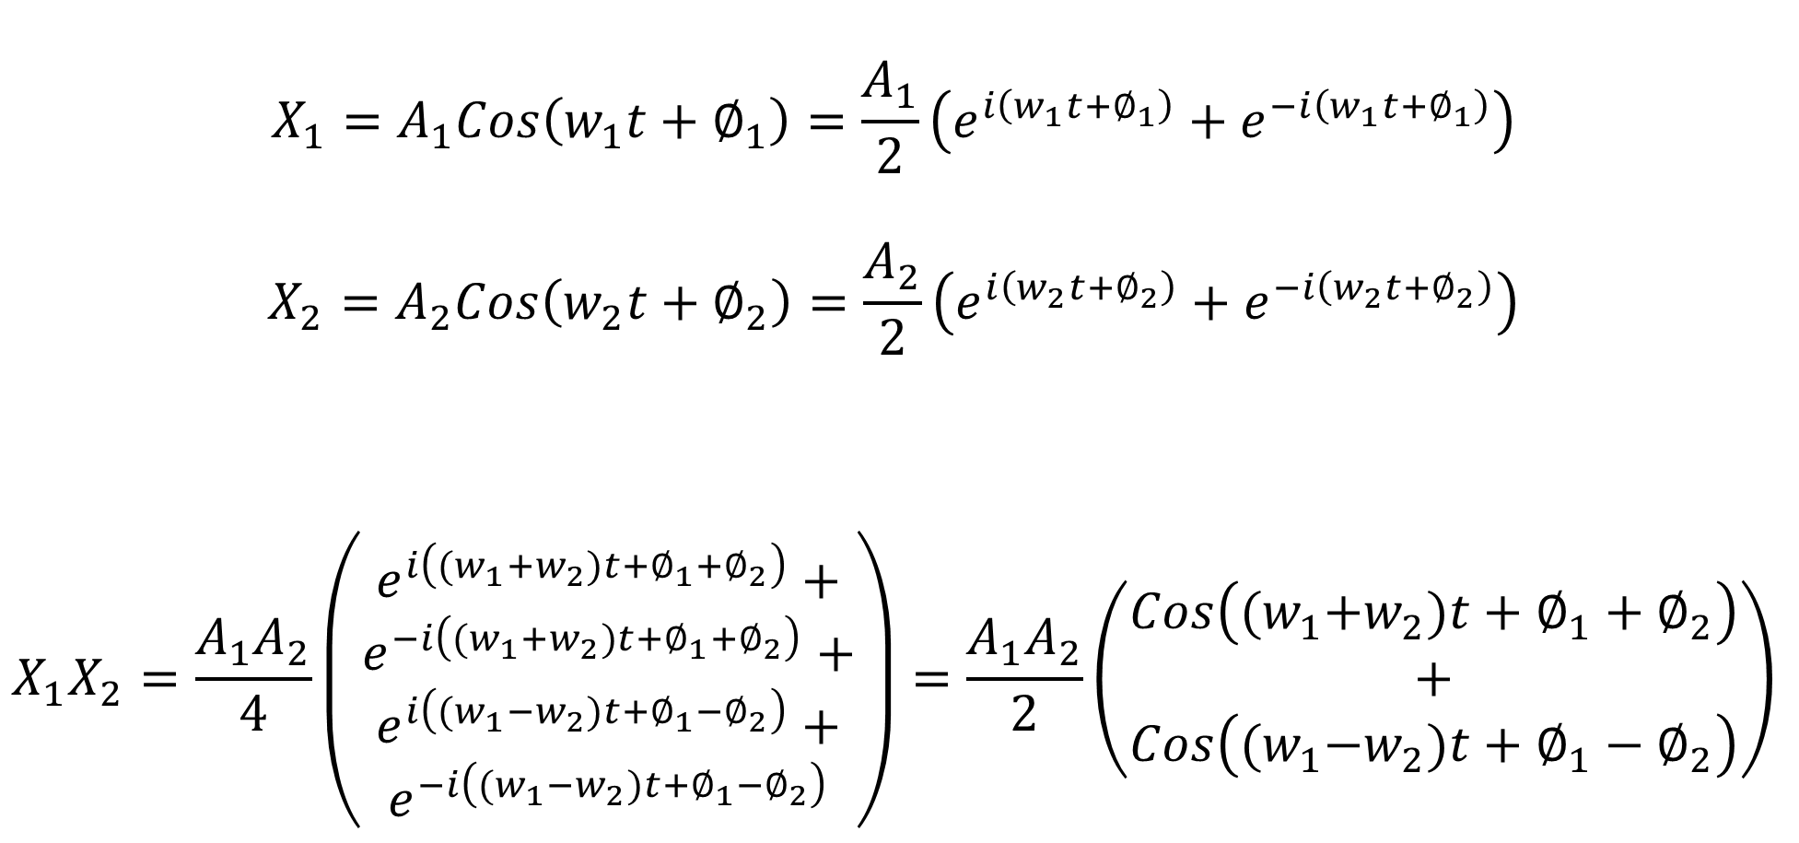
Signal Mixing
$$X_{1}=A_{1}Cos\left(w_{1}t+∅_{1}\right)=\frac{A_{1}}{2}\left(e^{i\left(w_{1}t+∅_{1}\right)}+e^{−i\left(w_{1}t+∅_{1}\right)}\right)$$
$$X_{2}=A_{2}Cos\left(w_{2}t+∅_{2}\right)=\frac{A_{2}}{2}\left(e^{i\left(w_{2}t+∅_{2}\right)}+e^{−i\left(w_{2}t+∅_{2}\right)}\right)$$
$$X_{1}X_{2}=\frac{A_{1}A_{2}}{4}\left(\begin{aligned}e^{i\left({(w}_{1}{+w}_{2})t+∅_{1}+∅_{2}\right)}+ \\ \begin{aligned}e^{−i\left({(w}_{1}{+w}_{2})t+∅_{1}+∅_{2}\right)}+ \\ \begin{aligned}e^{i\left({(w}_{1}{−w}_{2})t+∅_{1}−∅_{2}\right)}+ \\ e^{−i\left({(w}_{1}{−w}_{2})t+∅_{1}−∅_{2}\right)}\end{aligned}\end{aligned}\end{aligned}\right)=\frac{A_{1}A_{2}}{2}\left(\begin{aligned}Cos\left({(w}_{1}+w_{2})t+∅_{1}+∅_{2}\right) \\ + \\ Cos\left({(w}_{1}−w_{2})t+∅_{1}−∅_{2}\right)\end{aligned}\right)$$
Notes:
Two signals of different frequencies

Slide 7
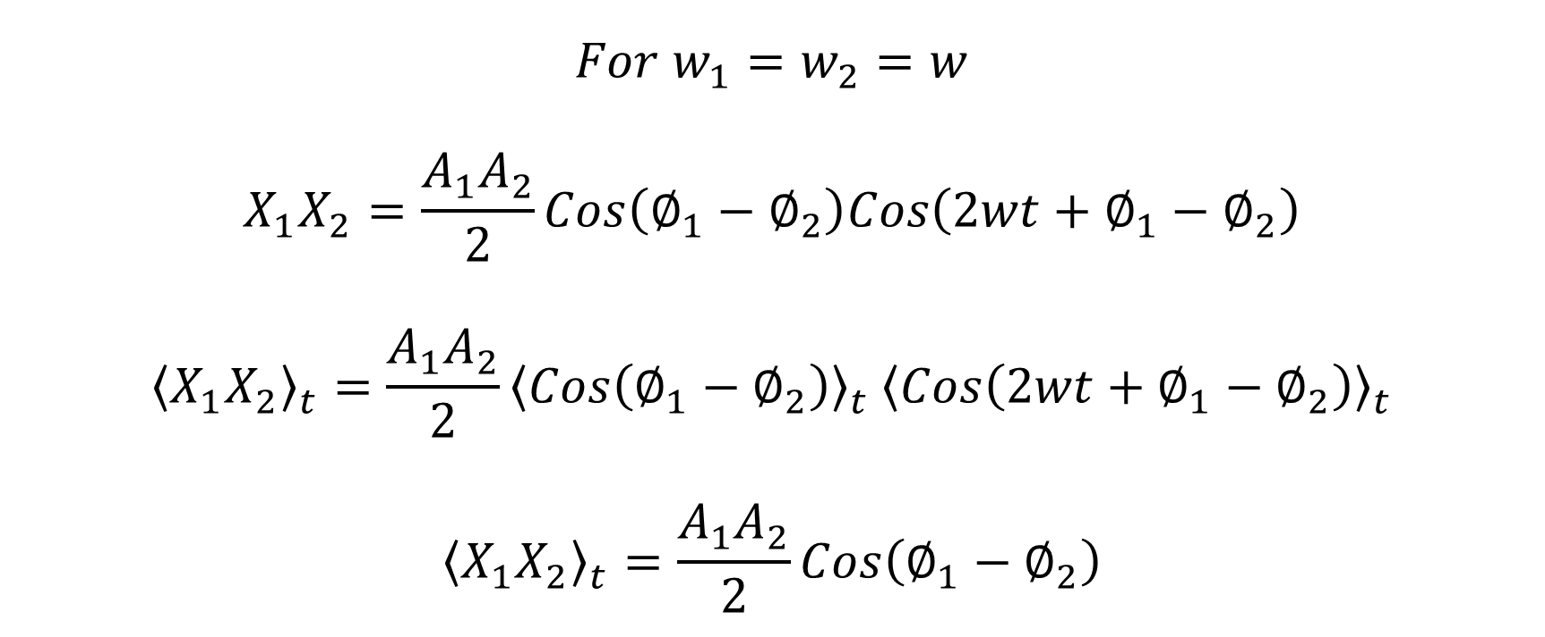
Signal Mixing
$$For{ w}_{1}=w_{2}=w$$
$$X_{1}X_{2}=\frac{A_{1}A_{2}}{2}Cos\left(∅_{1}−∅_{2}\right)Cos\left(2wt+∅_{1}−∅_{2}\right)$$
$${\left\langle X_{1}X_{2}\right\rangle }_{t}=\frac{A_{1}A_{2}}{2}{\left\langle Cos\left(∅_{1}−∅_{2}\right)\right\rangle }_{t} {\left\langle Cos\left(2wt+∅_{1}−∅_{2}\right)\right\rangle }_{t}$$
$${\left\langle X_{1}X_{2}\right\rangle }_{t}=\frac{A_{1}A_{2}}{2}Cos\left(∅_{1}−∅_{2}\right)$$

Slide 8
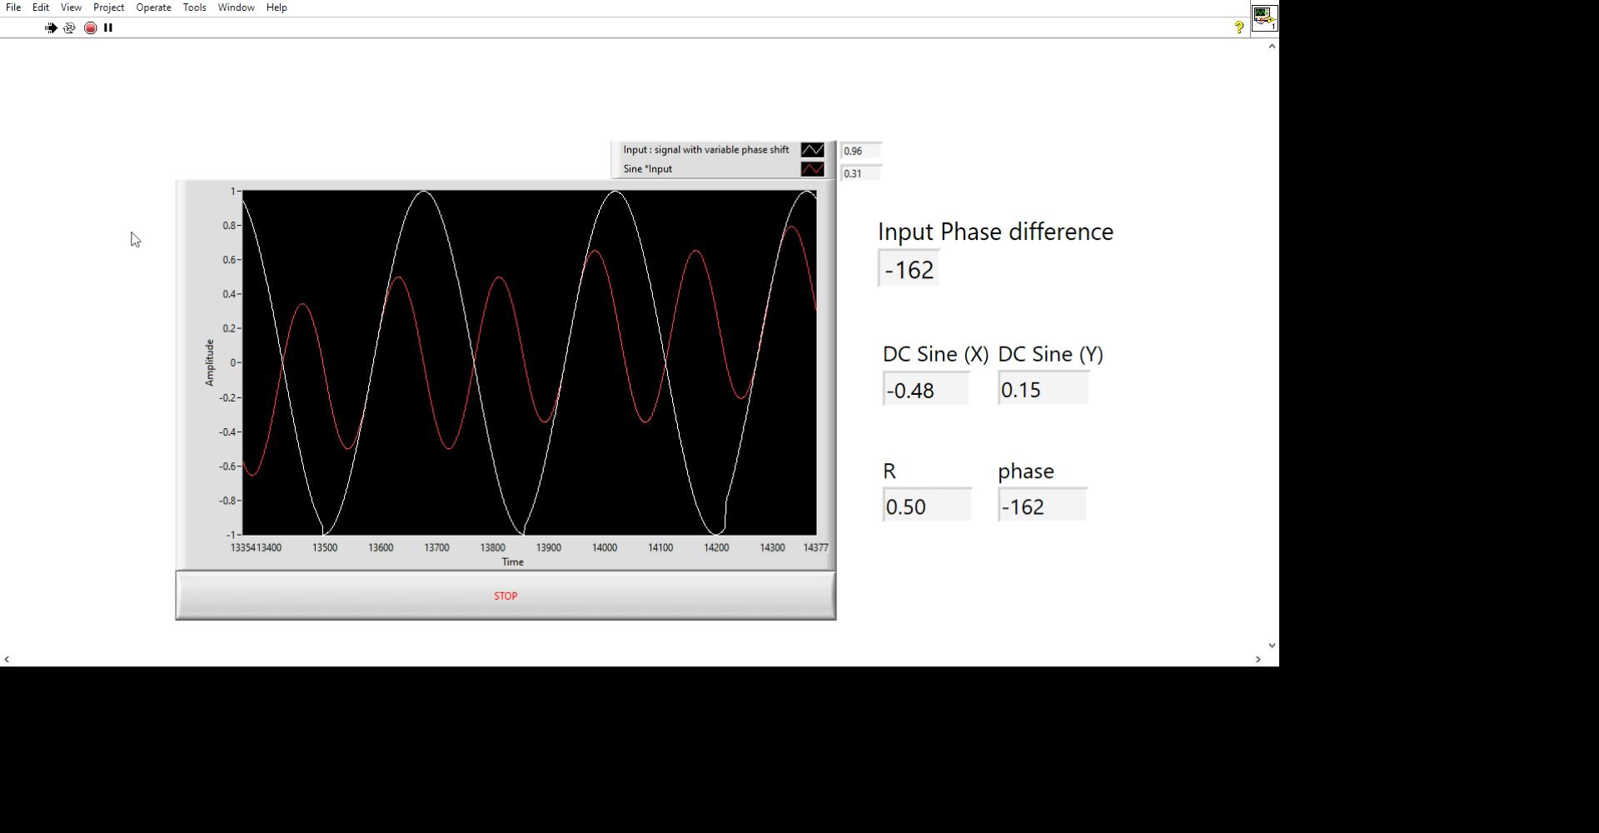
Extracting Phase and Amplitude information
Changing Input Phase
Phase Information extracted by signal Mixing and demodulating
Notes:
The plot in white colour is the input and the plot in red one is the output

Slide 9
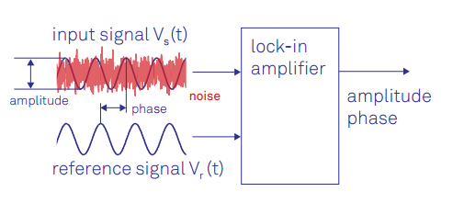
Lock-in Amplifier – An Advanced noise removing method
Lock-in amplifiers are capable of measuring the amplitude and the phase of a signal relative to a defined reference signal, even if the signal is buried in noise

Slide 10
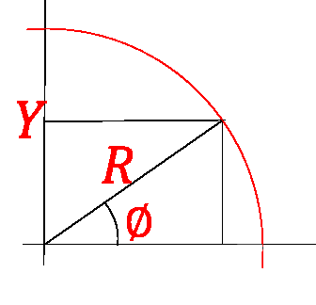
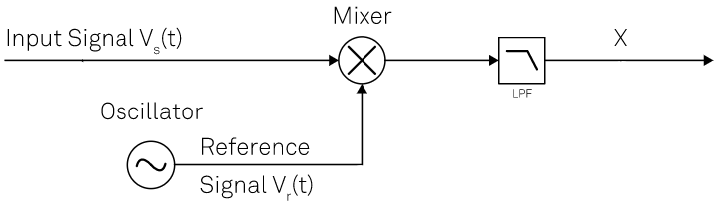



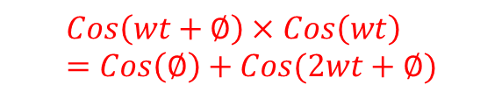

Principle of Phase Sensitive Detection
$$Cos\left(wt+∅\right)×Cos\left(wt\right)=Cos\left(∅\right)+Cos(2wt+∅)$$
$$Cos⁡(wt+∅)$$
$$Cos⁡(∅)$$
$$X$$
$$Cos⁡(wt)$$
The Real Part

Slide 11
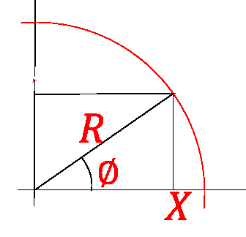


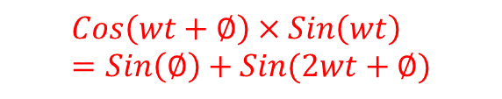
Principle of Phase Sensitive Detection
Y
$$Cos\left(wt+∅\right)×Sin\left(wt\right)=Sin\left(∅\right)+Sin(2wt+∅)$$
$$Sin(∅)$$
$$Cos⁡(wt+∅)$$
Y
$$Sin⁡(wt)$$
The Quadrature Part

Slide 12
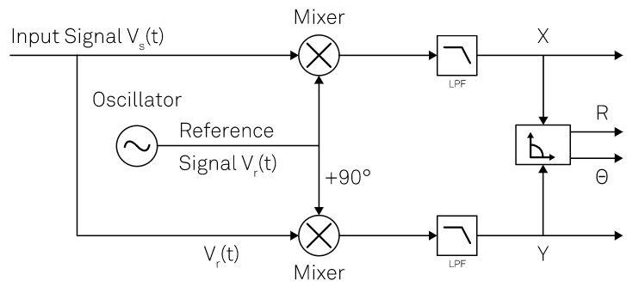
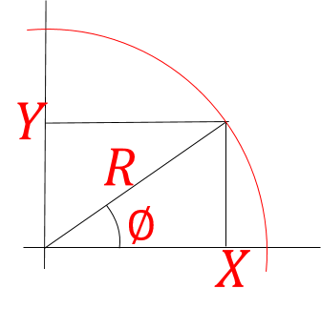
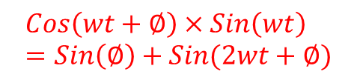
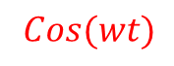
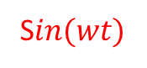

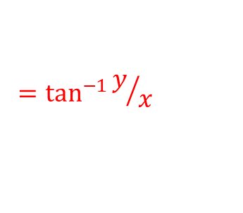
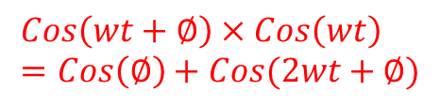
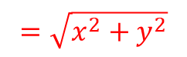


Principle of Dual Phase Lock-in Amplifier
$$Cos\left(wt+∅\right)×Cos\left(wt\right)=Cos\left(∅\right)+Cos(2wt+∅)$$
$$Cos⁡(wt+∅)$$
$$Cos(∅)$$
$$=\sqrt{x^{2}+y^{2}}$$
$$Cos⁡(wt)$$
S$in⁡(wt)$
$$=\tan^{−1}{y/x}$$
$$Sin⁡(∅)$$
$$Cos\left(wt+∅\right)×Sin\left(wt\right)=Sin\left(∅\right)+Sin(2wt+∅)$$

Slide 13
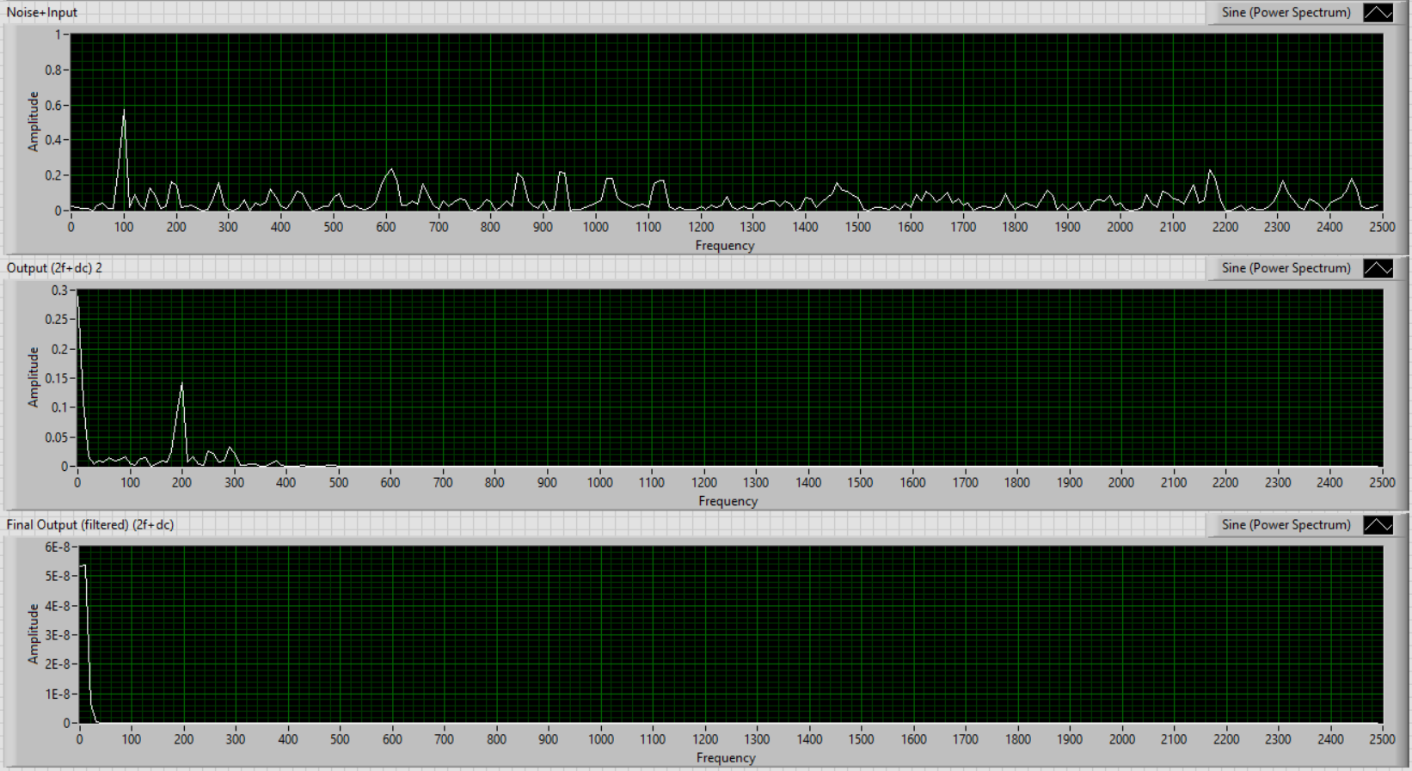
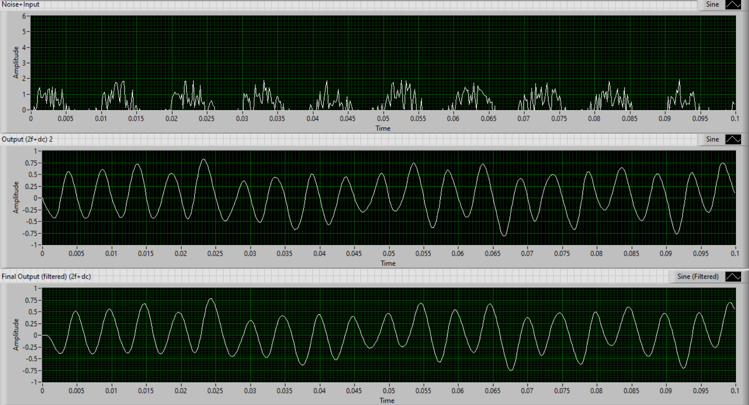

100Hz signal with noise
Signal
DC
$$2∗w$$
DC

Slide 14
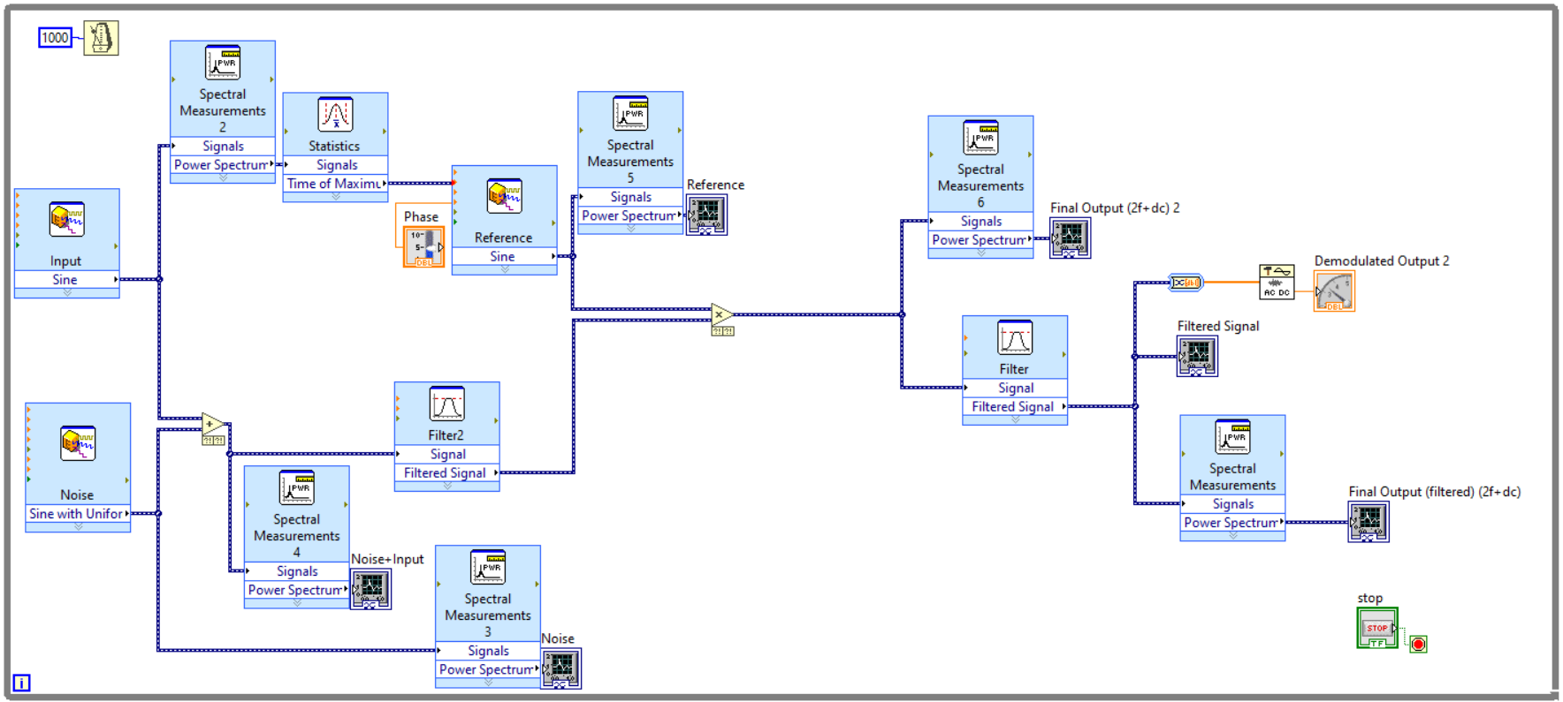

A Digital Lock-in Amplifier
Reference signal
Noise + Signal
$$DC$$
Notes:
Start with multiplication

Slide 15
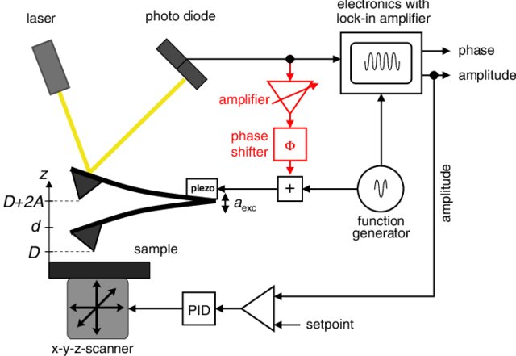
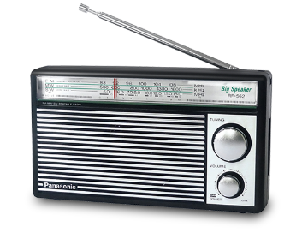

Application of Lock-in Amplifiers can be found in many every day Technologies, Physics and other Fields in Research
Atomic Force Microscope
Radio and telecommunication

Slide 16
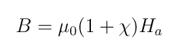
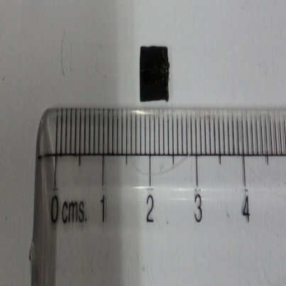
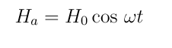
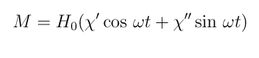
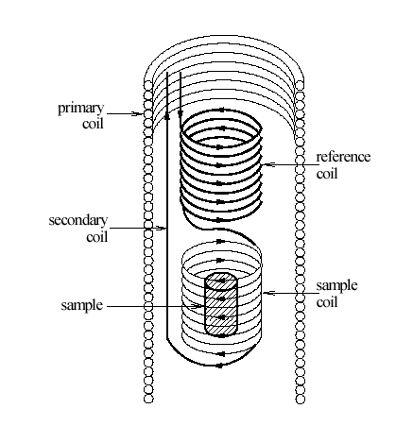
AC Susceptometer – A Case Study
AC Susceptometer is used to measure changes in magnetic field due to the presence of a magnetic sample
Sample and T-sensor

Slide 17
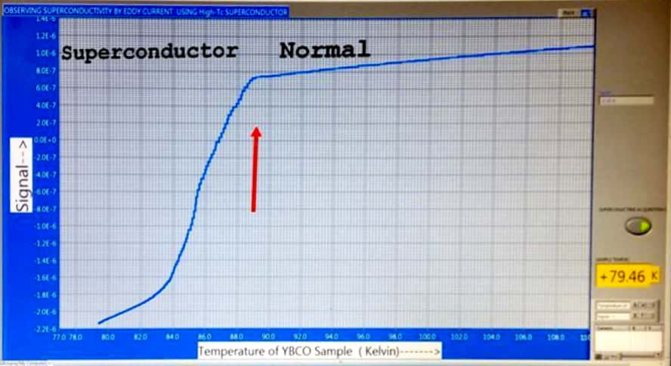
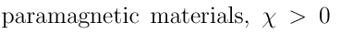
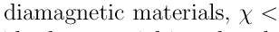
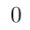
Magnetic Phase Transition of YBCO
Source: Superconductiviting Transition by using Mutual-inductance coil, Joby , Sumit , Vineet and A.K.Rastogi
Notes:
An implementation of this idea was done at iuac

Slide 18
Tasks Achieved
Learning LabVIEW programming
Mathematics of signal mixing
Designing a program for observing signal mixing and extracting phase
Mathematics of different filters
Simulating a low-pass filter in LabVIEW and generating a bode plot
Case study of AC susceptometer as an application
References
https://www.zhinst.com/americas/resources/principles-lock-detection
Sabyasachi Bhattacharyya et al 2016 J. Phys.: Conf. Ser. 759 012096
AC Susceptibility Measurements in High-Tc Superconductors, Experiment ACS, University of Florida

